Slide 1
Tutorial 2 - WE-I Project Environment Setup & Development Flow
Prof. Ren-Shuo Liu Willie Tsai

Slide 2
WE-I Project Development Flow
TensorFlow
Model
Development
Firmware
Development
Download img file
Run / Update
Application
On WE-I
Convert
Debug
Stage | TensorFlow Model Development | Firmware Development | Run / Update Application On WE-I
Tool | Anaconda Cygwin | Cygwin Metaware or ARC GNU VirtualBox (Ubuntu 20.04) | Tera Term USB Micro
Language | Python 3 | C language C++ language

Slide 3
WE-I Project Development Flow
TensorFlow
Model
Development
Firmware
Development
Download img file
Run / Update
Application
On WE-I
Convert
Debug
Stage | TensorFlow Model Development | Firmware Development | Run / Update Application On WE-I
Tool | Anaconda Cygwin | Cygwin Metaware or ARC GNU VirtualBox (Ubuntu 20.04) | Tera Term USB Micro
Language | Python 3 | C language C++ language

Slide 4
Firmware Development
Any editor for C or C++
Use any tool which supports $make command
Toolchain: Metaware or GNU
VirtualBox
for Ubuntu
Program
Code
Compile
Project
Create elf and map file
Convert img file

Slide 5
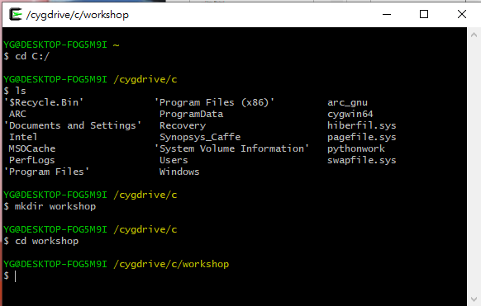
Download and Setup SDK
Open Cygwin64 Terminal
$ cd c: (to your working file path)
$ mkdir workshop (Suggest create a new folder named “workshop”)
$ cd workshop

Slide 6
Download and Setup SDK
Commands in cygwin64 terminal
Download SDK from Himax Github $ git clone https://github.com/HimaxWiseEyePlus/himax_tflm.git
Go to the root of Himax SDK $ cd himax_tflm
Download third party files (3 packages) $ make download
Download SDK from Synopsys Github $ git clone https://github.com/worldskills2017tw/Synopsys_WEI.git

Slide 7
Download and Setup SDK
After these steps, your file structure will be like:
himax_tflm
|
----himax_we1_sdk
----image_gen_linux
----tensorflow
----third_party
----Synopsys_WEI | ----Example_Project ----User_Project ----doc_tutorial ----arc_bin

Slide 8
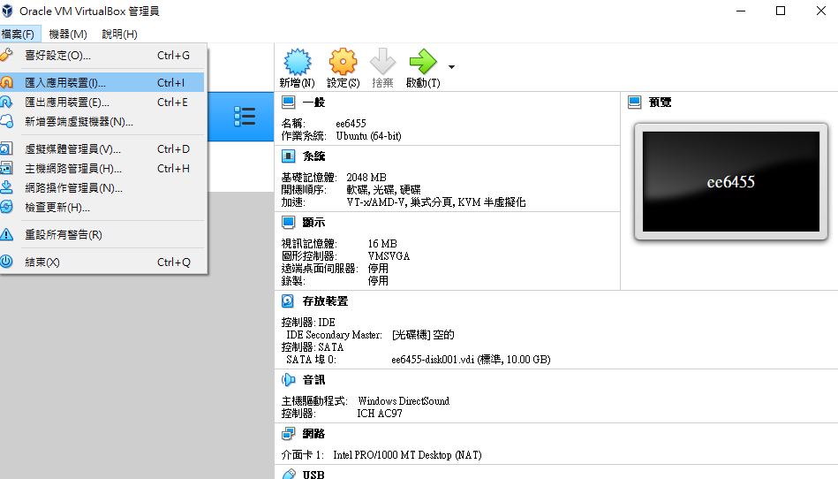
Download and Setup SDK
6. Setting Virtual Box Open Virtual Box > 檔案 > 匯入應用裝置

Slide 9
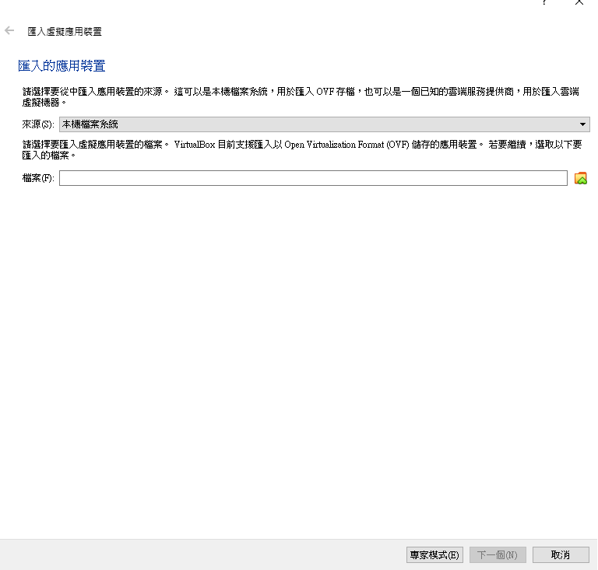
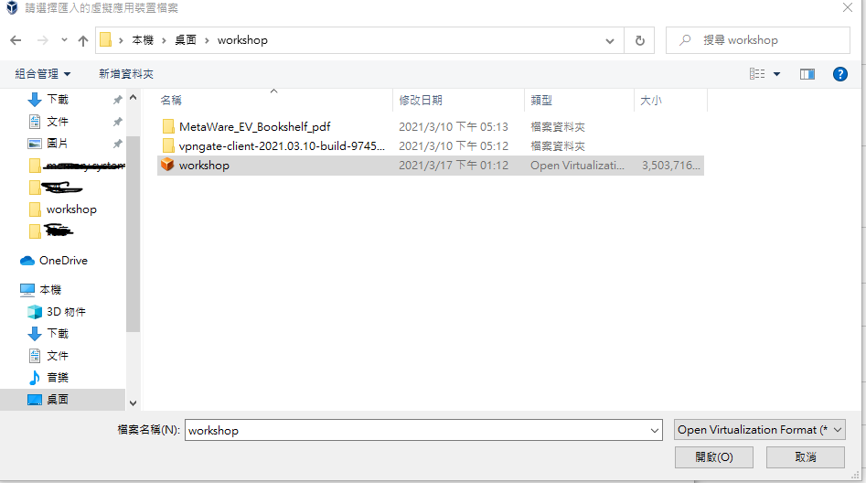
Download and Setup SDK
解壓縮雲端下載的Workshop.zip 匯入workshop.ova

Slide 10
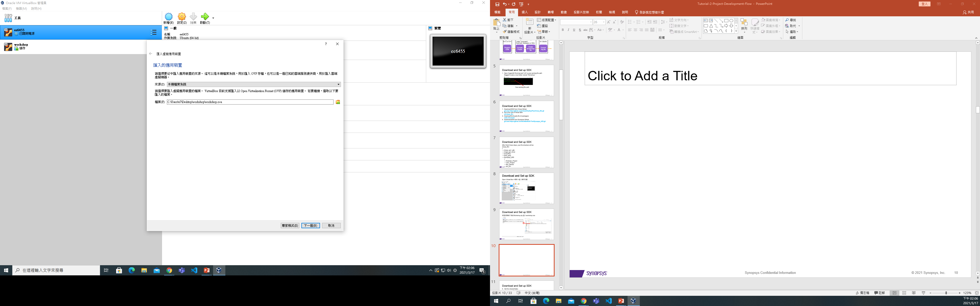
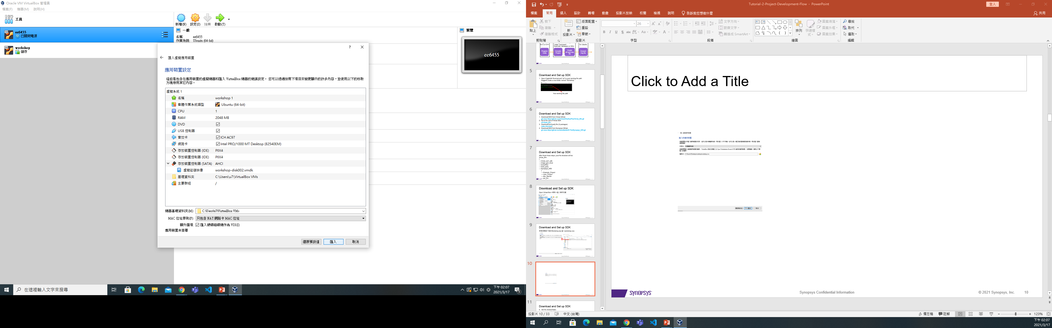
Download and Setup SDK
下一個 > 匯入

Slide 11
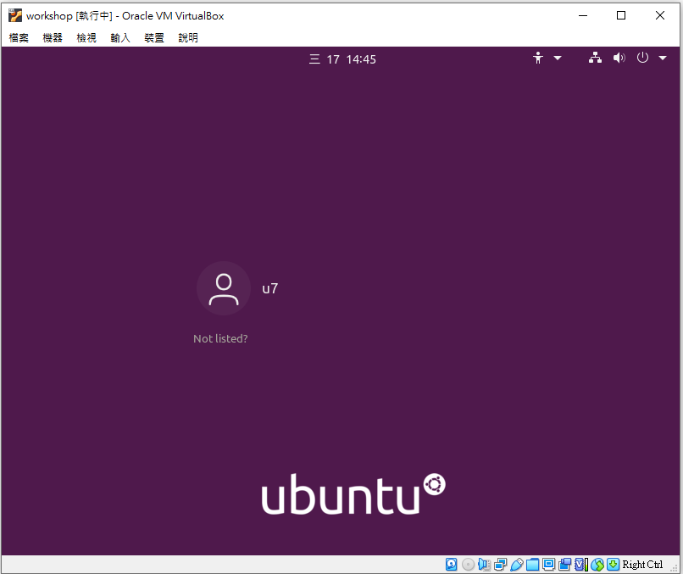
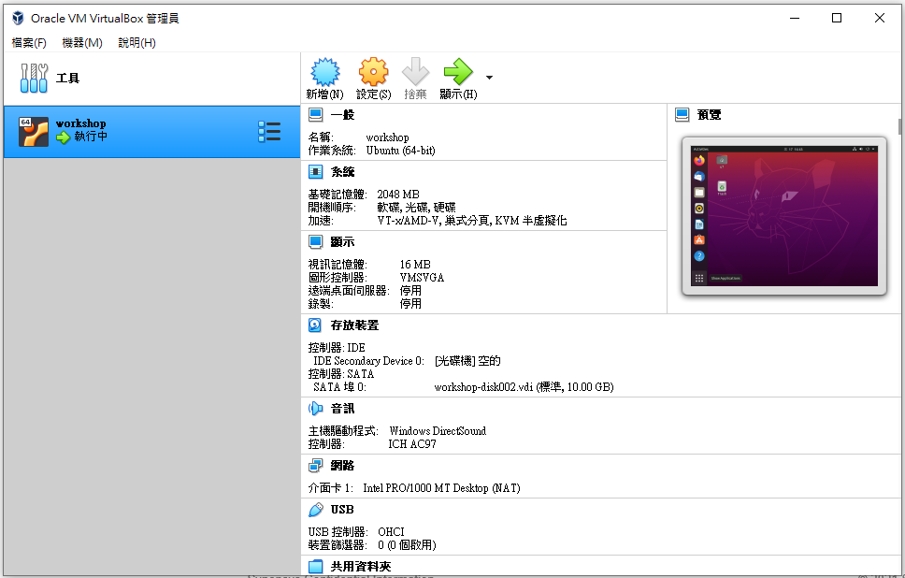
Download and Setup SDK
啟動 > 點選u7 > 輸入密碼: u1234567

Slide 12
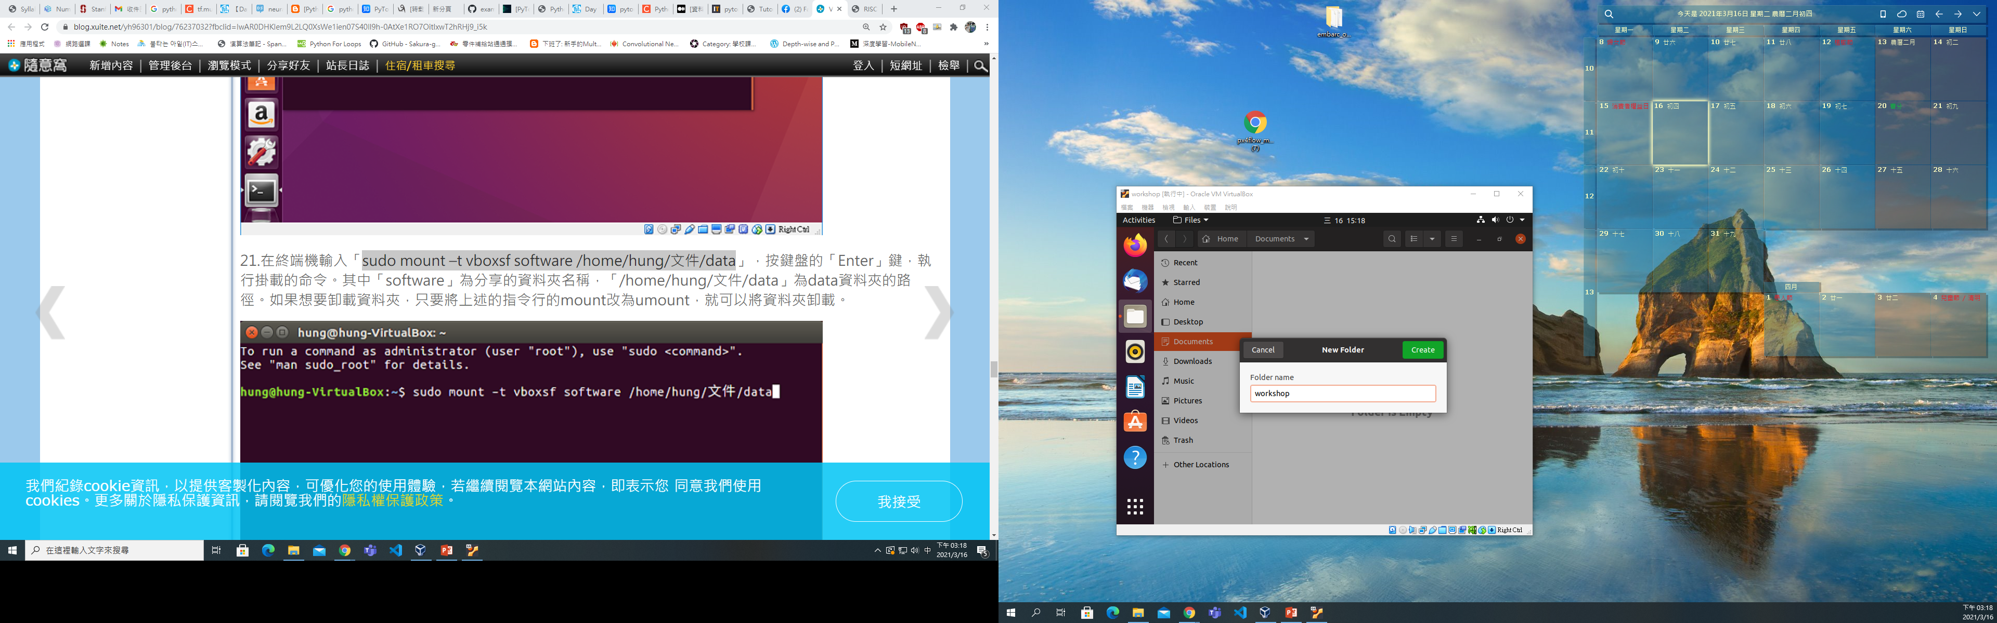
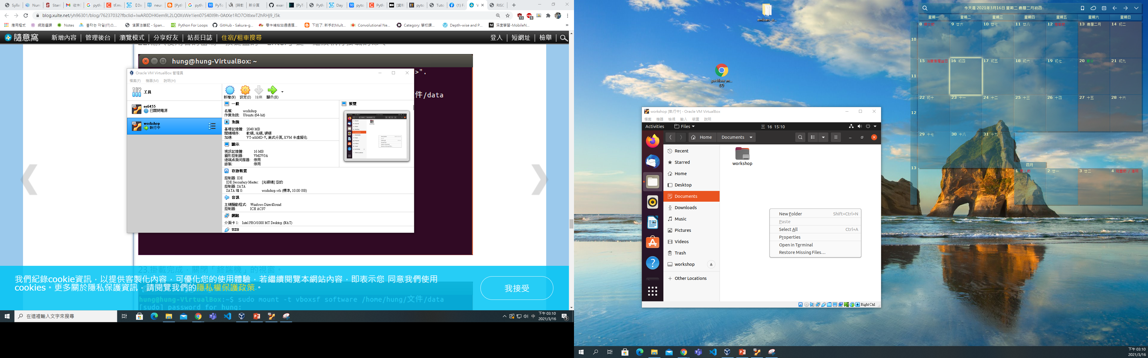
Download and Setup SDK
Create a new folder at Home/Documents (Already done by out workshop.ova)

Slide 13
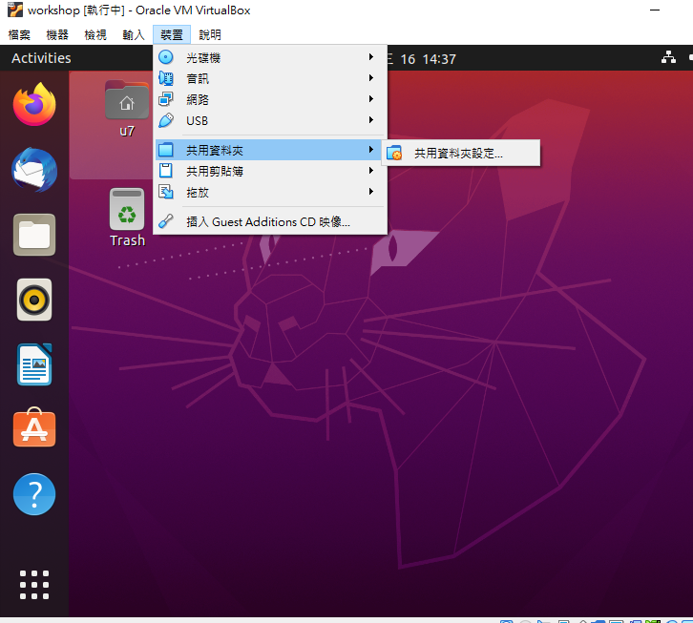
Download and Setup SDK
Set the folder to be shared

Slide 14
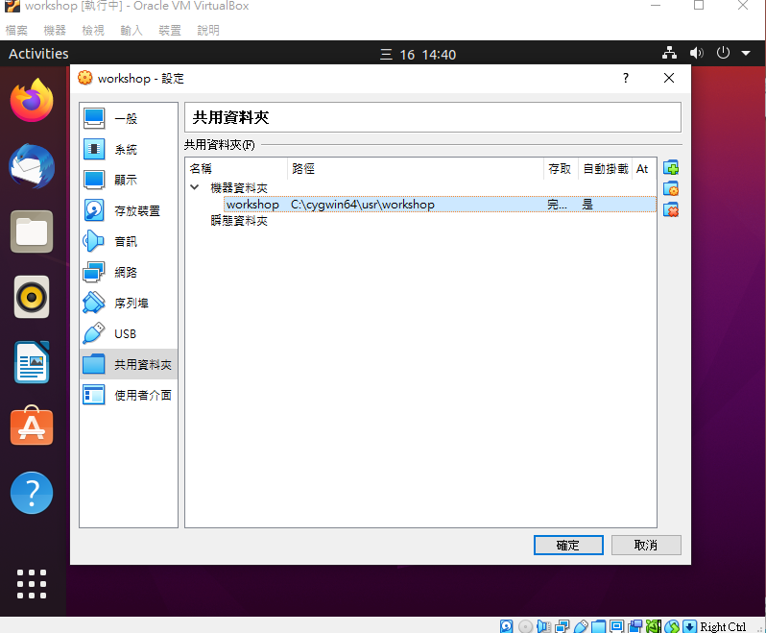
Download and Setup SDK

Slide 15
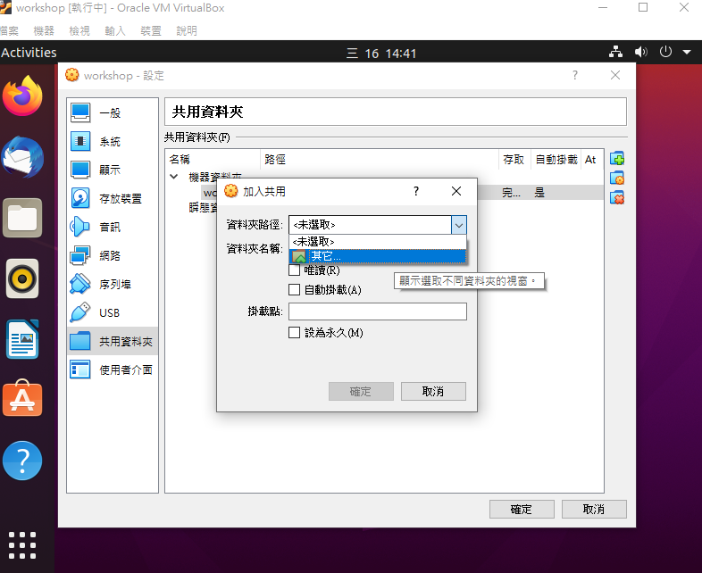
Download and Setup SDK

Slide 16
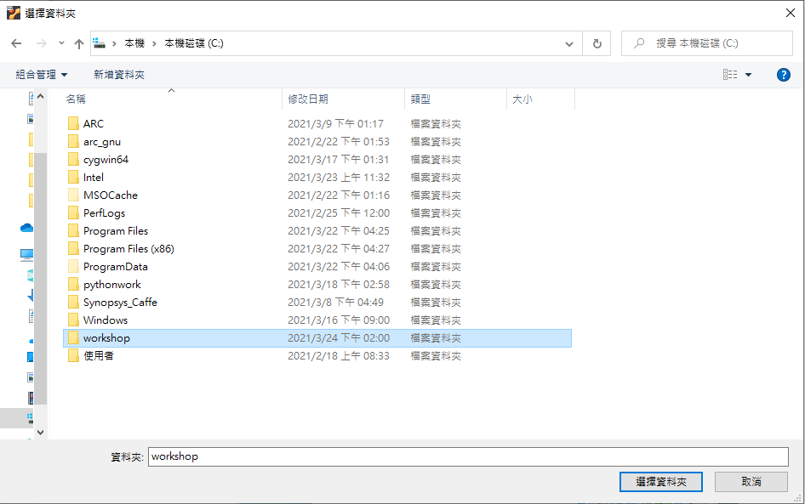
Download and Setup SDK
Path C:\workshop

Slide 17
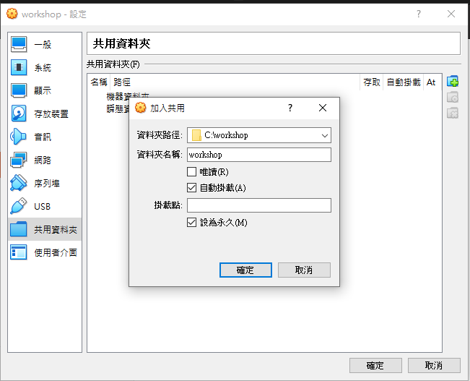
Download and Setup SDK

Slide 18
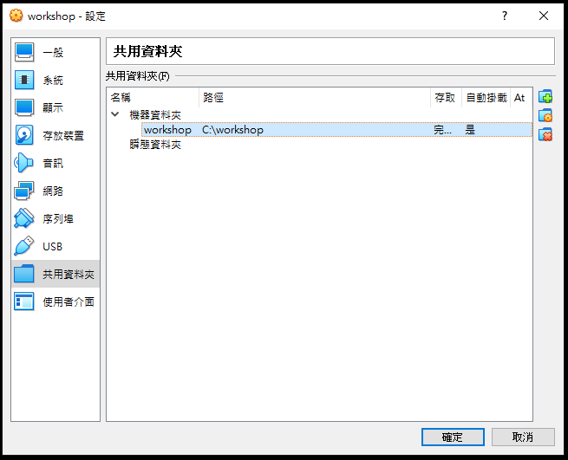
Download and Setup SDK

Slide 19
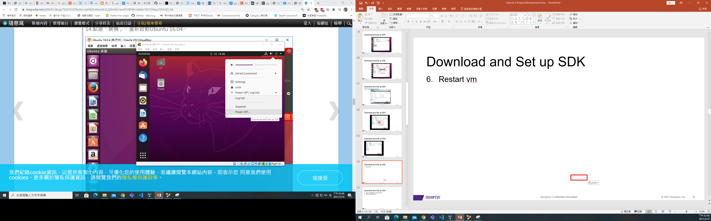
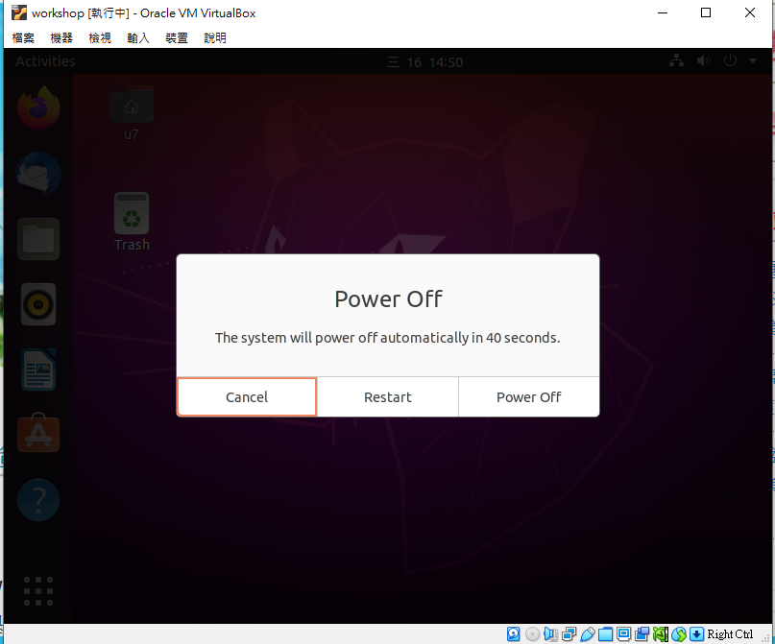
Download and Setup SDK
Restart

Slide 20
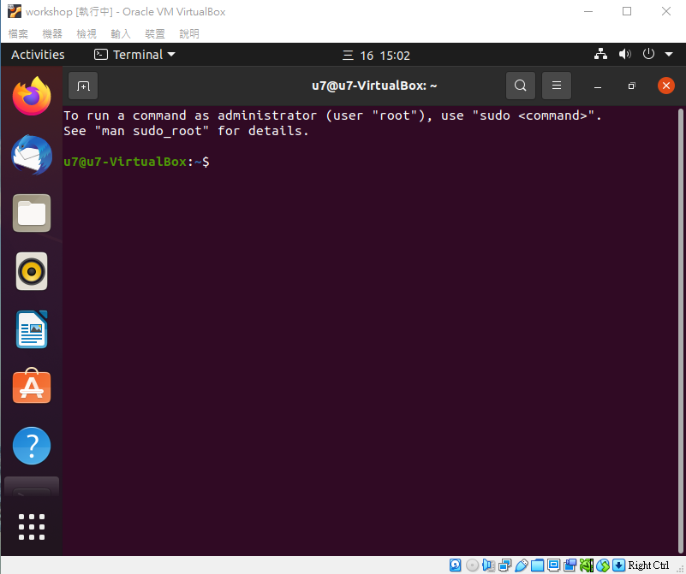
Download and Setup SDK
Open Ubuntu terminal: Ctrl+Alt+t

Slide 21
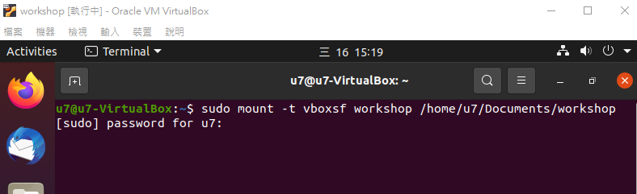
Download and Setup SDK
$ sudo mount –t vboxsf workshop /home/u7/Documents/workshop
password for u7: u1234567

Slide 22
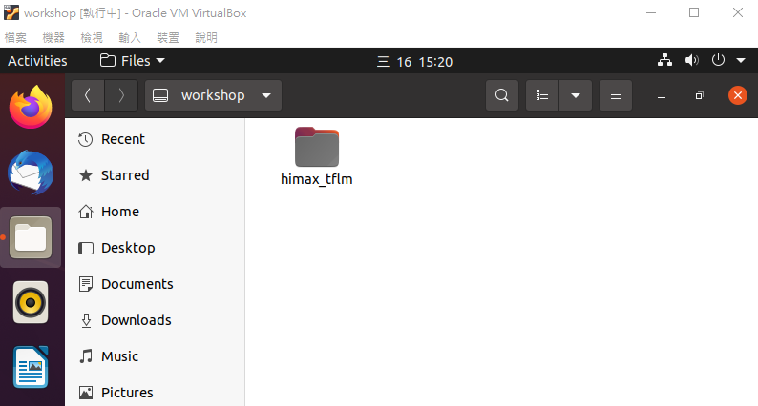
Download and Setup SDK
Check workshop file again to confirm whether file is shared. Step 8 & 9 has already done by workshop.ova file. If you create Ubuntu by yourself, please do step 8 & 9.
(SKIP) Copy “…\himax_tflm\Synopsys_WEI\arc_bin” to “Home/arc_bin”
(SKIP) Edit /home/.bashrc for setting environment variable, add “export PATH=$PATH:$HOME/arc_bin” at the last line

Slide 23
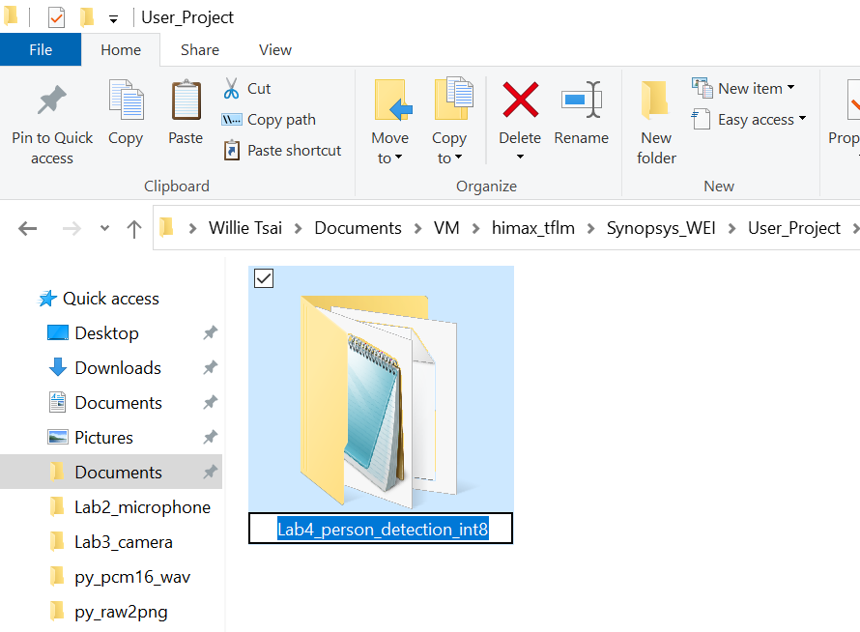
Program Code
Copy folder “Synopsys_WEI/Example Project/Lab4_person_detection_int8” to folder “Synopsys_WEI/User Project/”
Rename the folder “Lab4_person_detection_int8” to “Flow_Test”

Slide 24
Program Code
Go into folder “Flow_Test” you will see folder “src” and “inc” “src” folder: always keep your .c and .cc file in here. “inc” folder: always keep your .h file in here. (c file: c language) (cc file: c++ language)

Slide 25
Make Project (By cygwin64)
Go to your project path in cygwin64 terminal $ cd C: $ cd /workshop/himax_tflm/Synopsys_WEI/User_Project/Flow_Test $ make

Slide 26
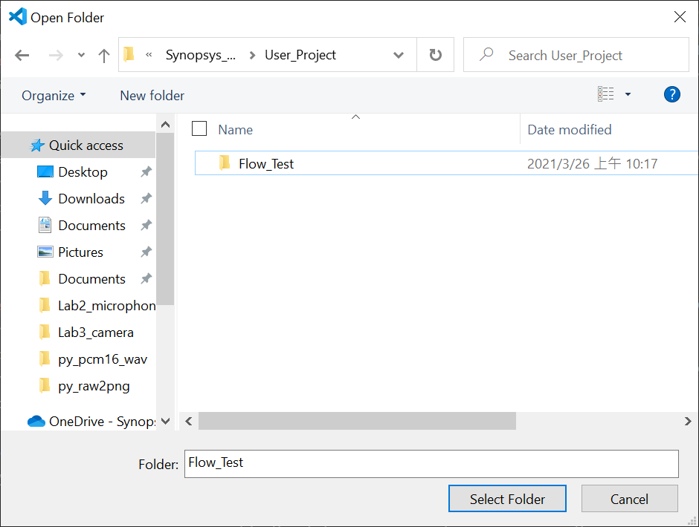
Make Project (Visual Studio Code)
You can also use Visual Studio Code to make project. Open Folder and Select Folder: /workshop/himax_tflm/Synopsys_WEI/User_Project/Flow_Tes

Slide 27
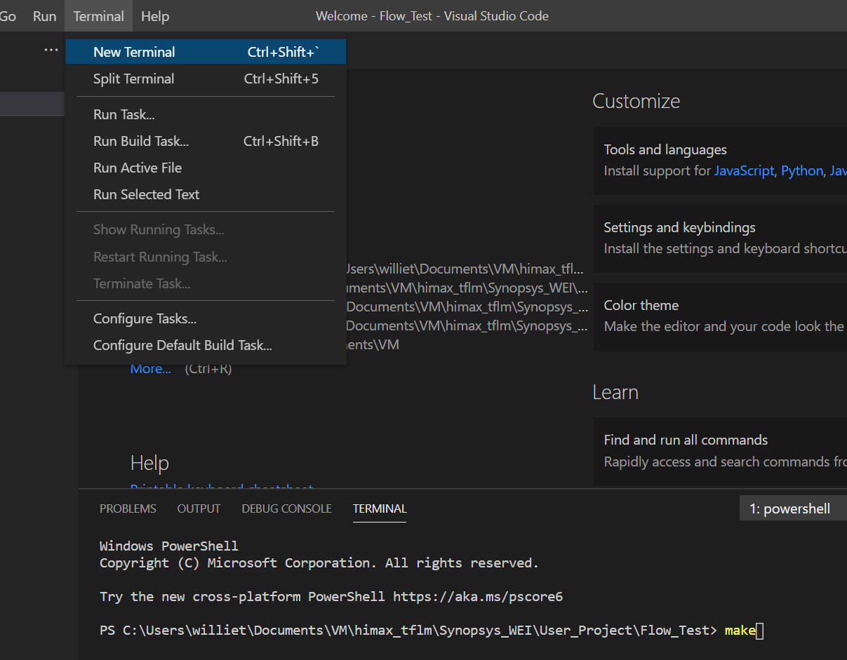
Make Project (Visual Studio Code)
Terminal > New Terminal You will see terminal block. Type command: $ make

Slide 28
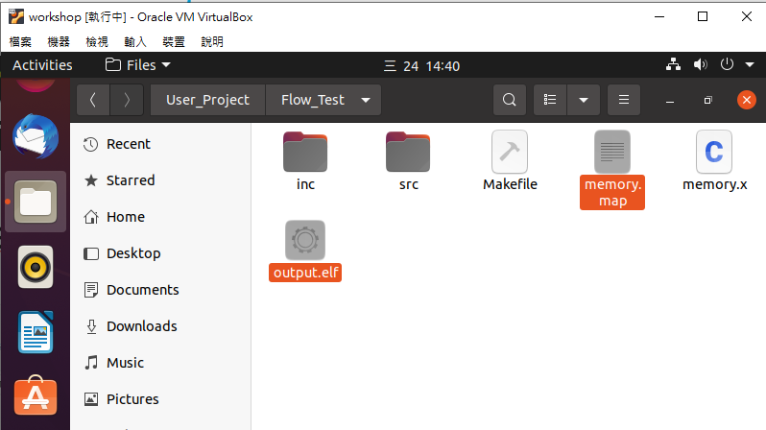
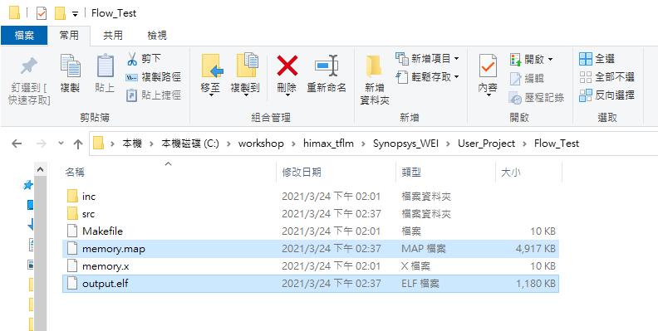
Make Project
Check your folder whether contains .elf and .map files. GNU: output.elf & memory.map MetaWare: output.elf & output.map

Slide 29
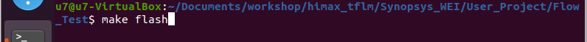
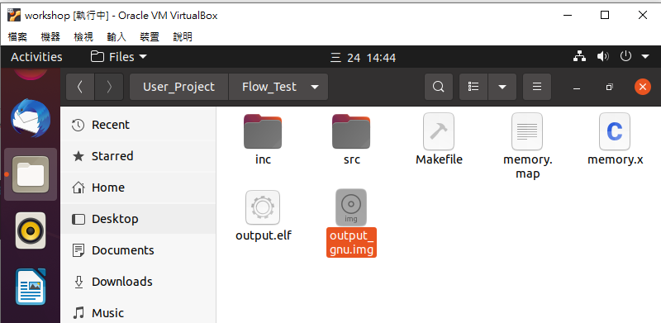
Make Flash File
Open terminal in VM, and go to the same path: “Documents/workshop/himax_tflm/Synopsys_WEI/User_Project/Flow_Test”
$ make flash
7. Check your img file in directory, it will be downloaded to WE-I.
GNU: output_gnu.img MetaWare: output_mwdt.img

Slide 30
Make Project and Flash File
There are some commands can be used, $ make : compile and link your project, then create .elf and .map file $ make flash : combine .elf and .map file to .img file $ make clean : remove all .o file of this project $ make clean_all : remove all .o file of this project and third party
You can add a command for changing toolchain (default toolchain is gnu, define in makefile) “ARC_TOOLCHAIN=mwdt”: compile with MetaWare “ARC_TOOLCHAIN=gnu”: compile with ARC GNU Toolchain Please use $ make clean_all before you change toolchain.

Slide 31
Project Development Flow
TensorFlow
Model
Development
Firmware
Development
Download img file
Run / Update
Application
On WE-I
Convert
Debug
Stage | TensorFlow Model Development | Firmware Development | Run / Update Application On WE-I
Tool | Anaconda Cygwin | Cygwin Metaware or ARC GNU VirtualBox (Ubuntu 20.04) | Tera Term USB Micro
Language | Python 3 | C language C++ language

Slide 32
Run / Update Application On WE-I
Running
Application
Mode
WE-I
Reset
Any Data from SPI in 0.3 sec
No
Yes
Update
Application
Mode

Slide 33
Update Application On WE-I
WE-I
Reset
and
run
WE-I
Reset
Any Data from SPI in 0.3 sec
Update
Application
Mode
Key “1”
Receive and Update Application
Yes
Tera Term
Prepare
img file
Transmit
Img file
by Xmodem

Slide 34
Update Application On WE-I Connect WE-I with Tera Term
Connect WE-I and PC by USB Cable
Check your WE-I usb port number Device Manager > Ports(COM & LPT) > USB Serial Port (COMx) x: This is your WE-I usb port number
Open tera term and select “COMx: USB Serial Port (COMx)”
Tera term Setting > Com Port > Change Baud to 115200, and keep other setting.
Reset WE-I by pushing SW2, you will see startup information on tera term.

Slide 35
Update Application On WE-I Enable Update Application Mode with Tera Term
Finish to connect WE-I with Tera Term
Click on any display area
Keep to press key “1” on the keyboard, and reset WE-I.
WE-I will start to receive img file by Xmodem
Tera term File > Transmit > XMODEM > Transmit > select img file
Wait for Transmit
Reset and run your application

Slide 36
Run Application On WE-I
Connect USB cable to power up WE-I you can also power up by 2.54 pitch connector
For debug easily, suggest to use Tera Term and print date or result
Start to develop your project, and debug your code

